Slide 1

Unveiling Market Insights : Analysing Spending Behaviour And Identifying Oppourtunities For Growth
Project Submitted by
ABINAYA.N
ANUSRI.R
ANANTHI.K
ANITHA.I

Slide 2
Introduction :
Overview :
Market research is a way of getting an overview of consumers' wants, needs and beliefs.
It can also involve discovering how they act.
The research can be used to determine how a product could be marketed.
Market research is a way that producers and the marketplace study the consumer and gather information about the consumers' needs.
There are two major types of market research:
primary research, which is sub-divided into quantitative and qualitative research, and secondary research.

Slide 3
Purpose :
Market research helps to identify and analyze the needs of the market, the market size and the competition.
Its techniques encompass both qualitative techniques such as focus groups, in-depth interviews, and ethnography, as well as quantitative techniques such as customer surveys, and analysis of secondary data.
It helps companies understand their target audience, evaluate market opportunities, and develop effective marketing campaigns.
By conducting research, businesses can gain a competitive advantage by making informed decisions based on data-driven insights.

Slide 4
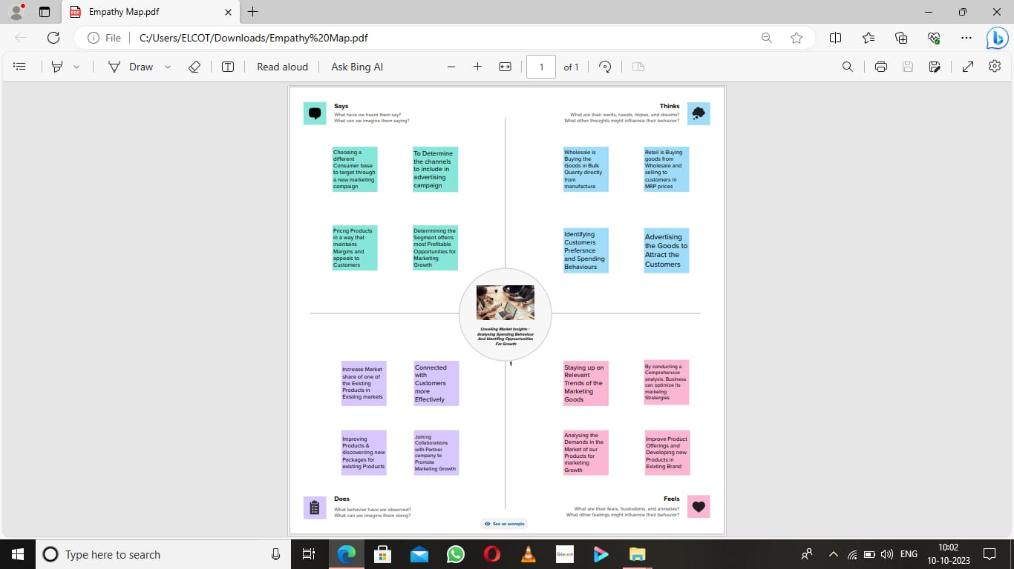
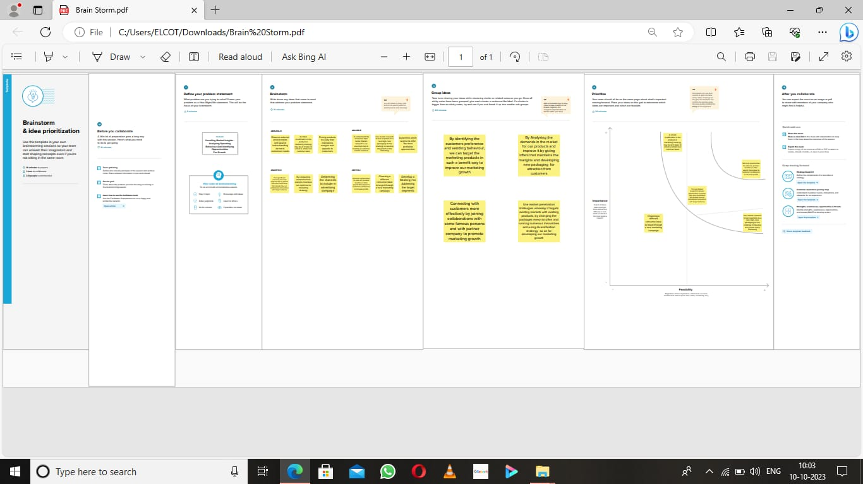
Problem Definition & Design Thinking
2.1 Empathy Map
2.2 Brain Stroming

Slide 5
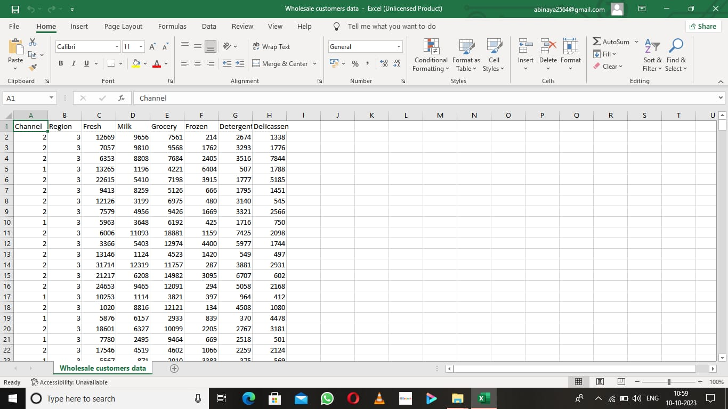
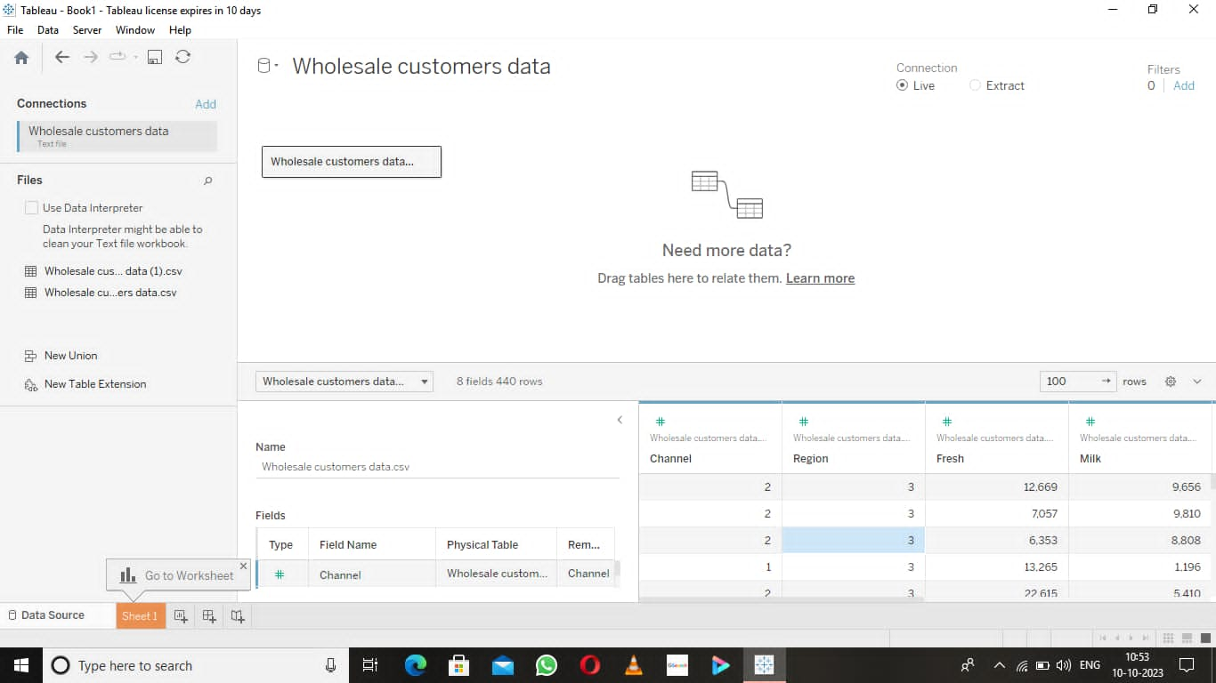
Data Collection & Extraction
Activity 1 : Downloading the Dataset
Activity 2: Connecting the Dataset
with Tableau

Slide 6
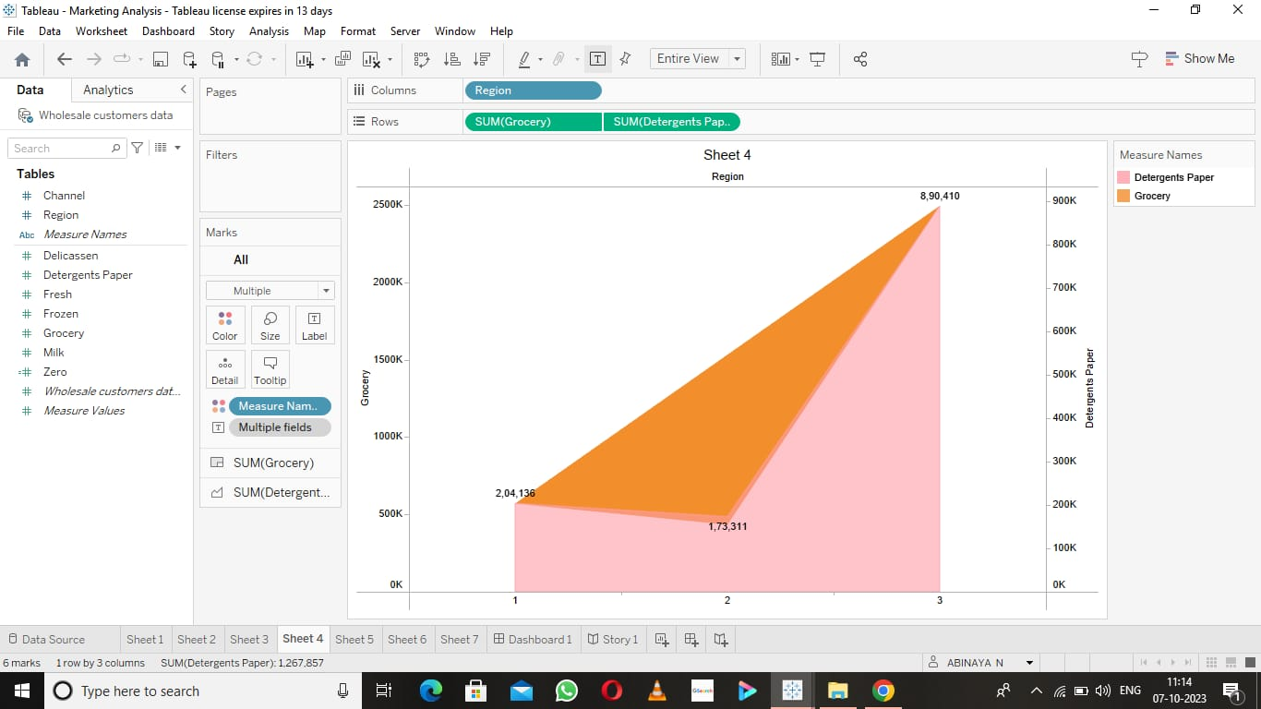
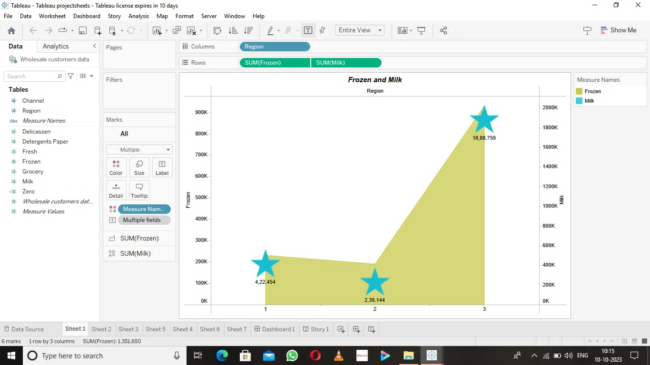
Activity 3: Data Visualization
3.1 : Region wise Grocery &
Detergent Paper
3.2 : Frozen and Milk

Slide 7
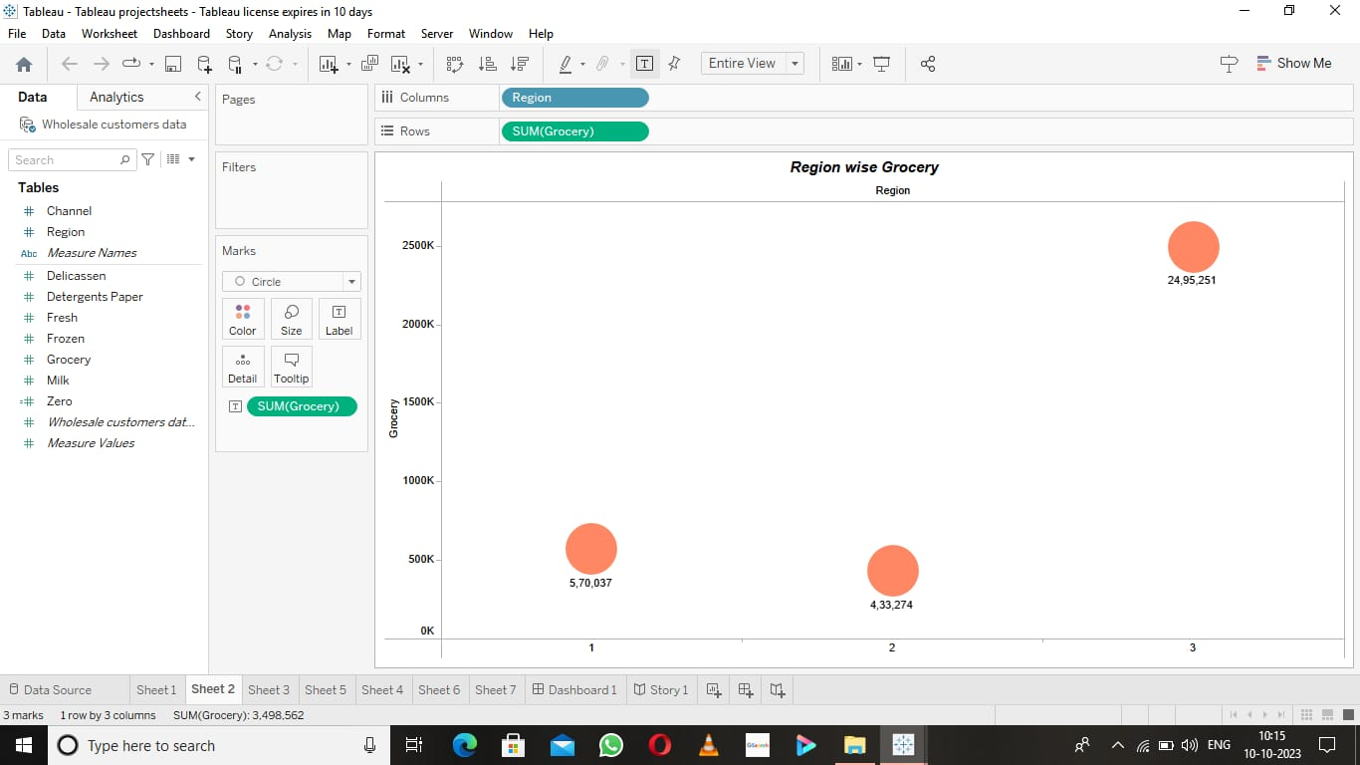
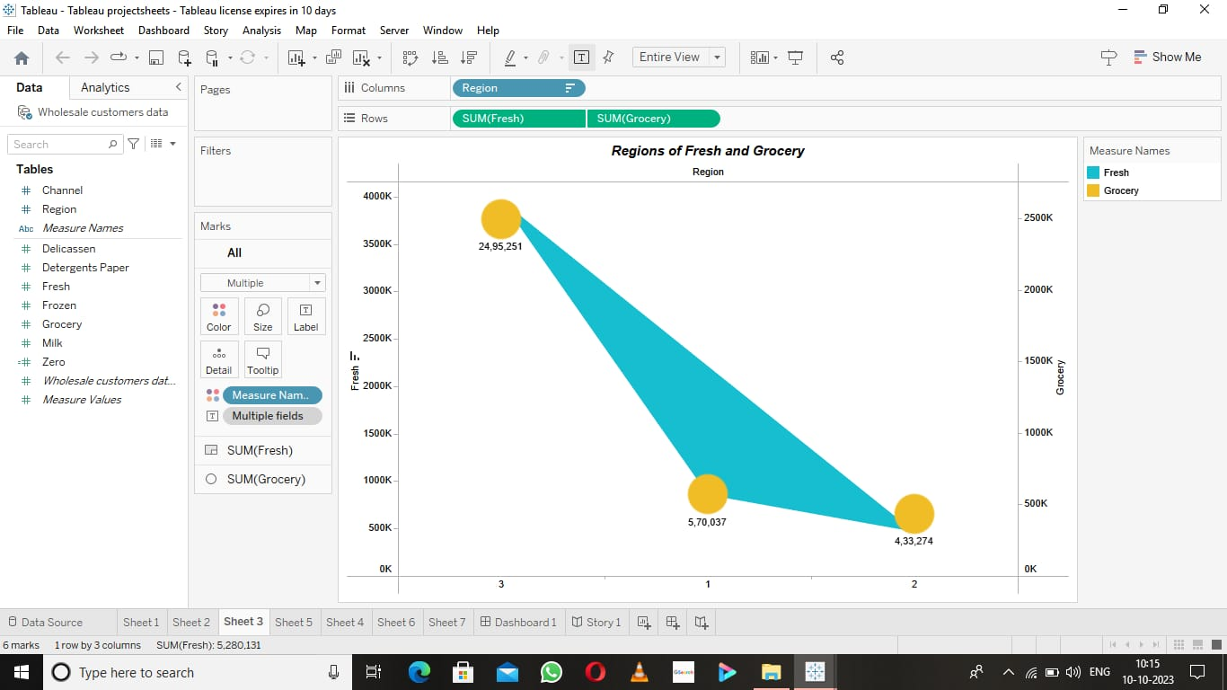
3.3 : Region wise Grocery
3.4 : Fresh and Grocery

Slide 8
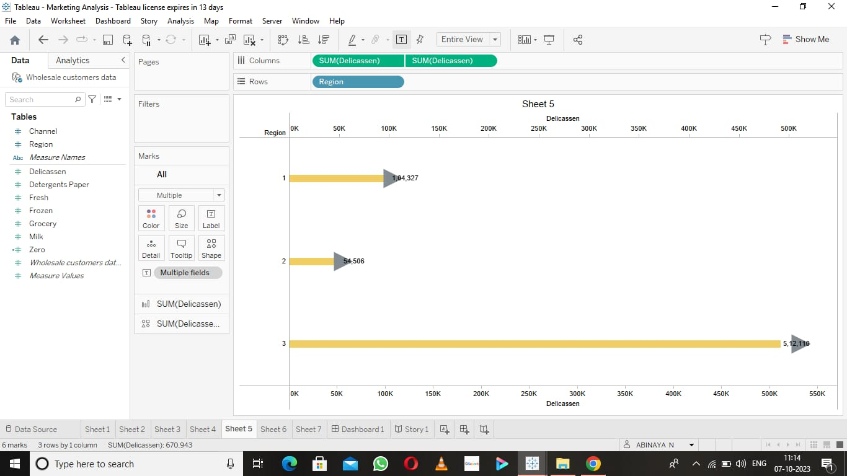
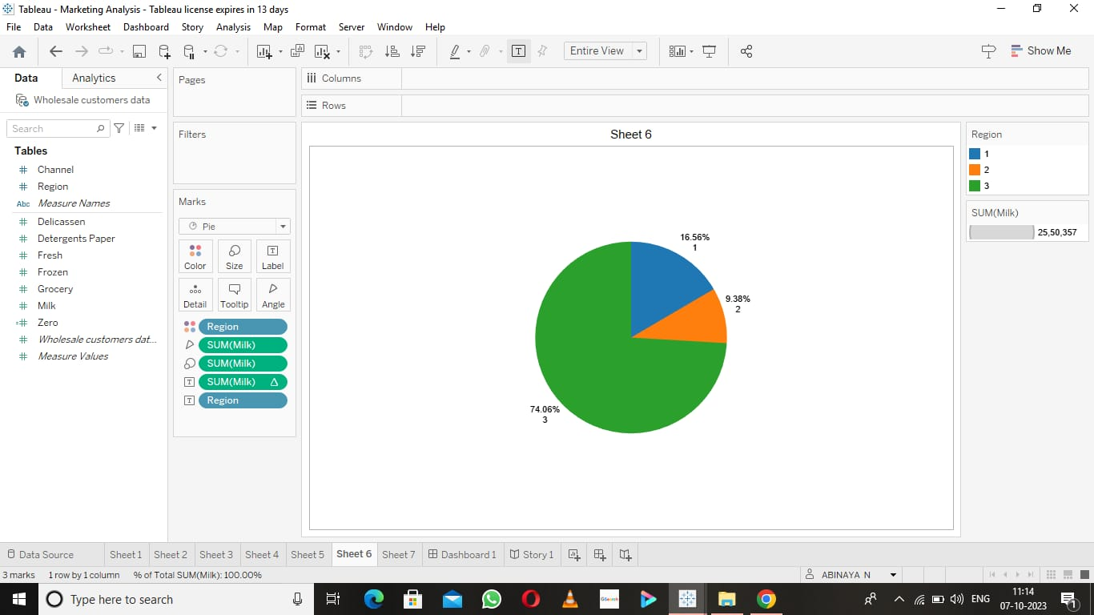
3.5 : Region wise Delicassen
3.6 : Pie Chart for Milk

Slide 9
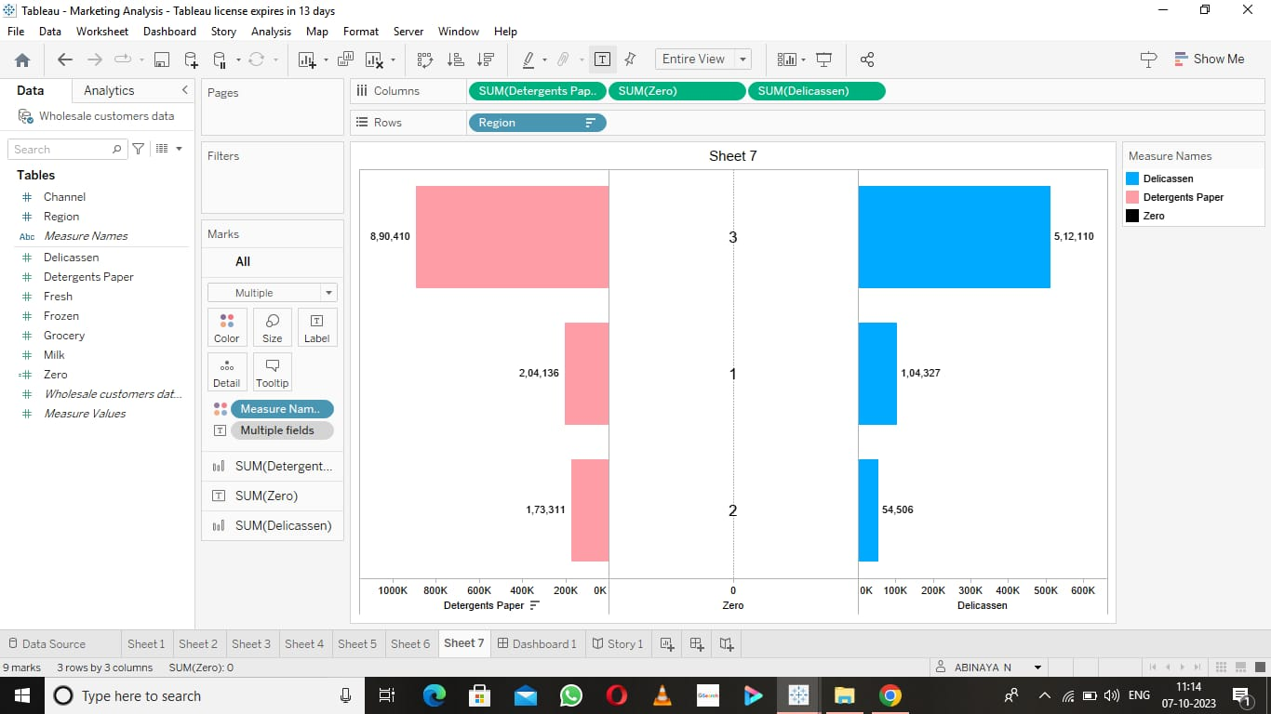
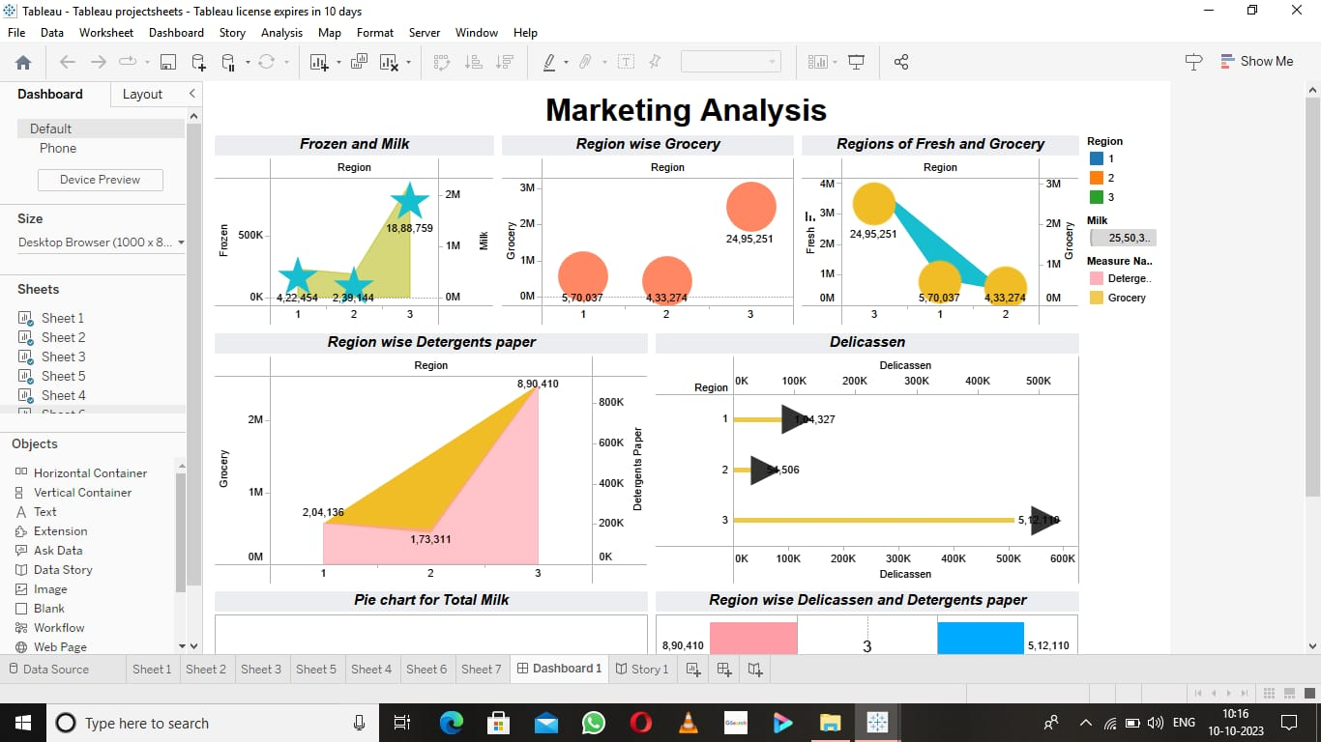
3.7 : Detergents paper and Delicassen
Activity 4 : Dashboard
4.1 : Dashboard of Marketing Analysis

Slide 10
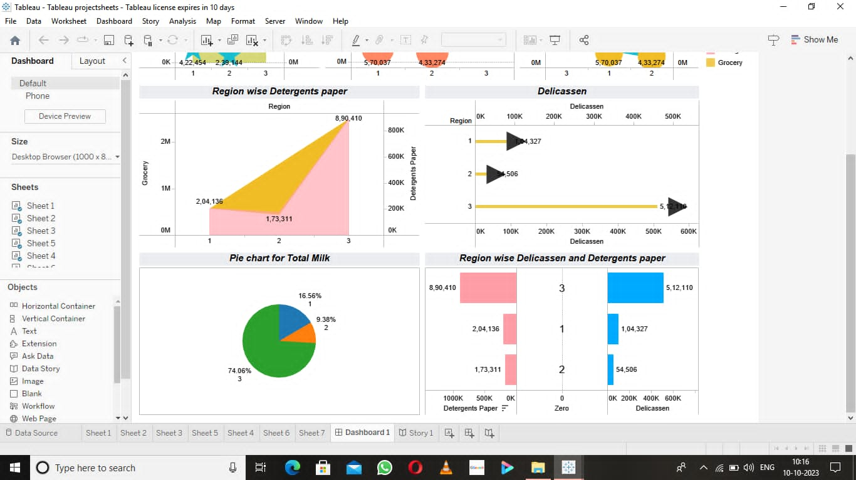
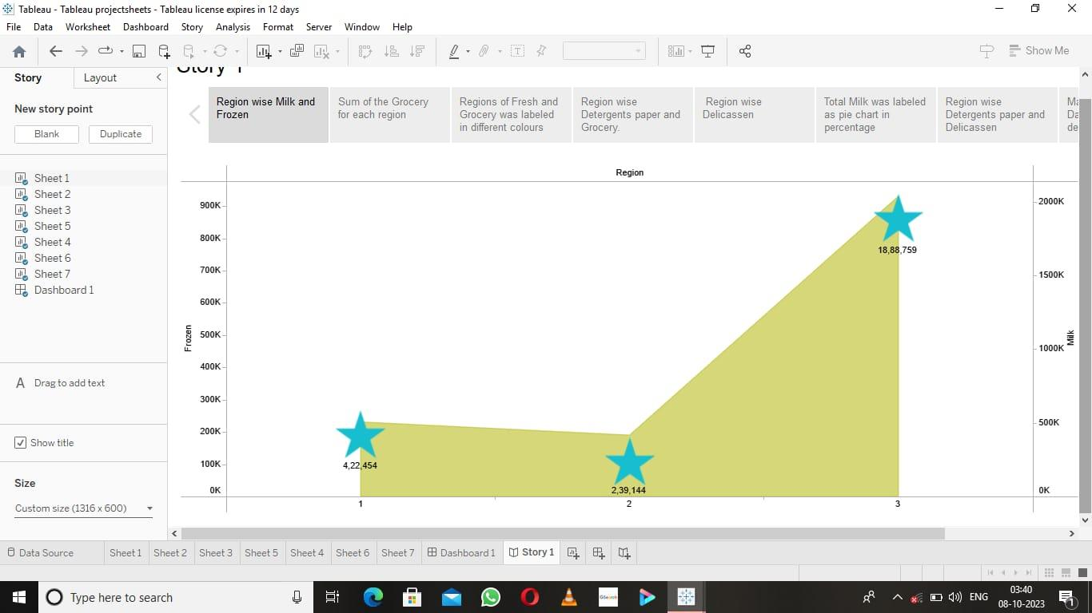
4.1 : Dashboard of Marketing Analysis
Activity 5 : Story
5.1 : Story of Marketing Analysis

Slide 11
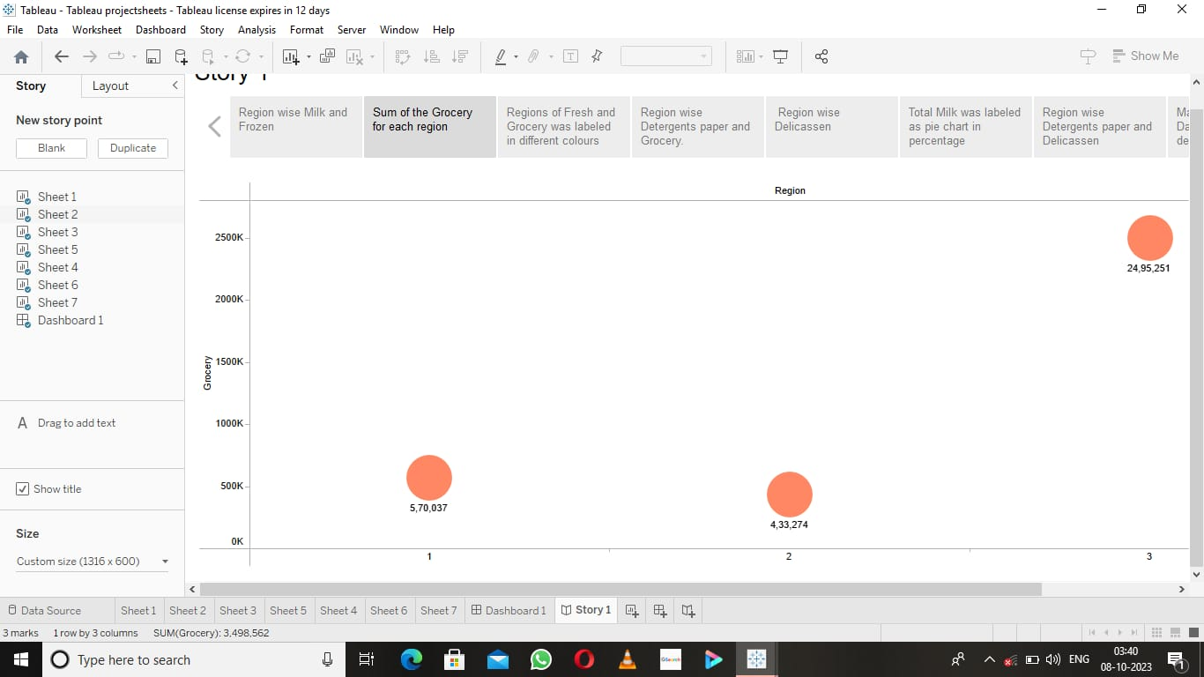
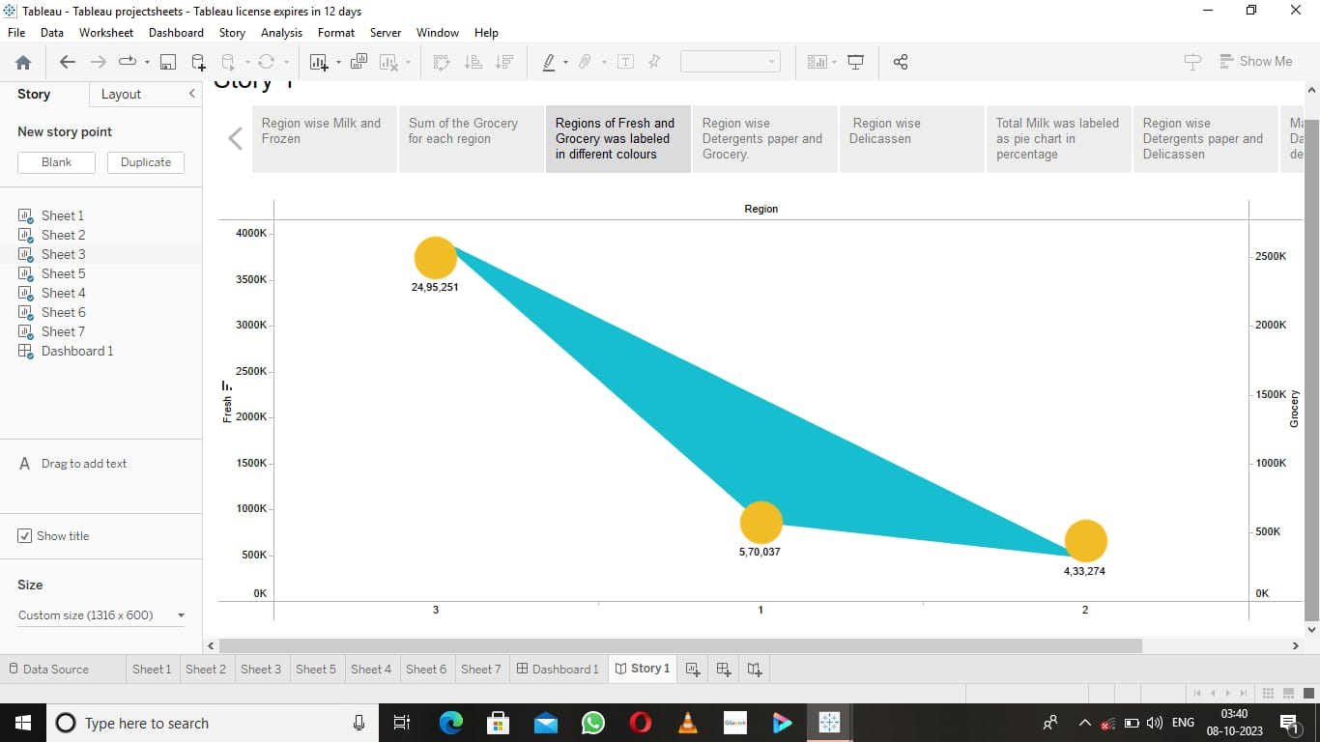

Slide 12
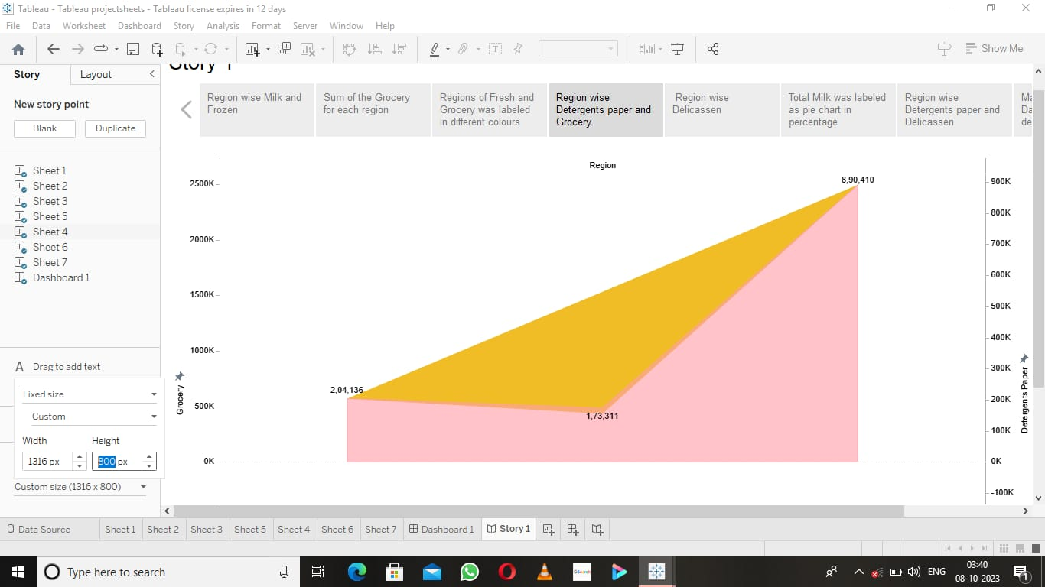
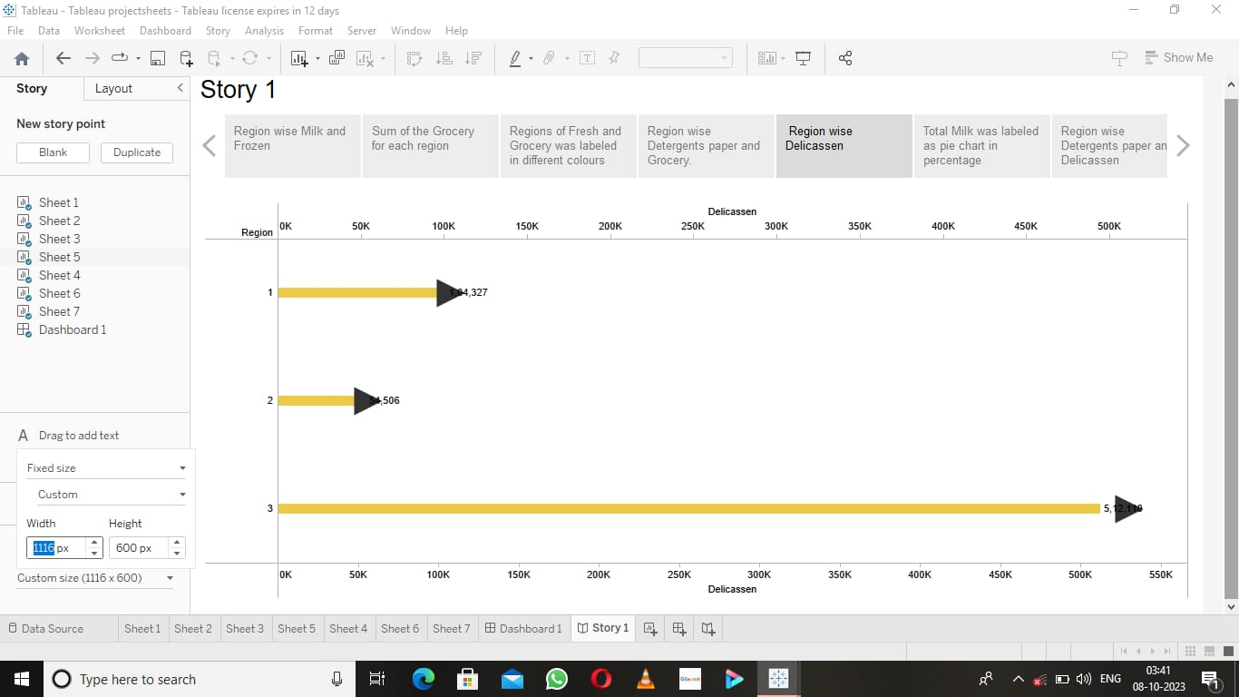

Slide 13
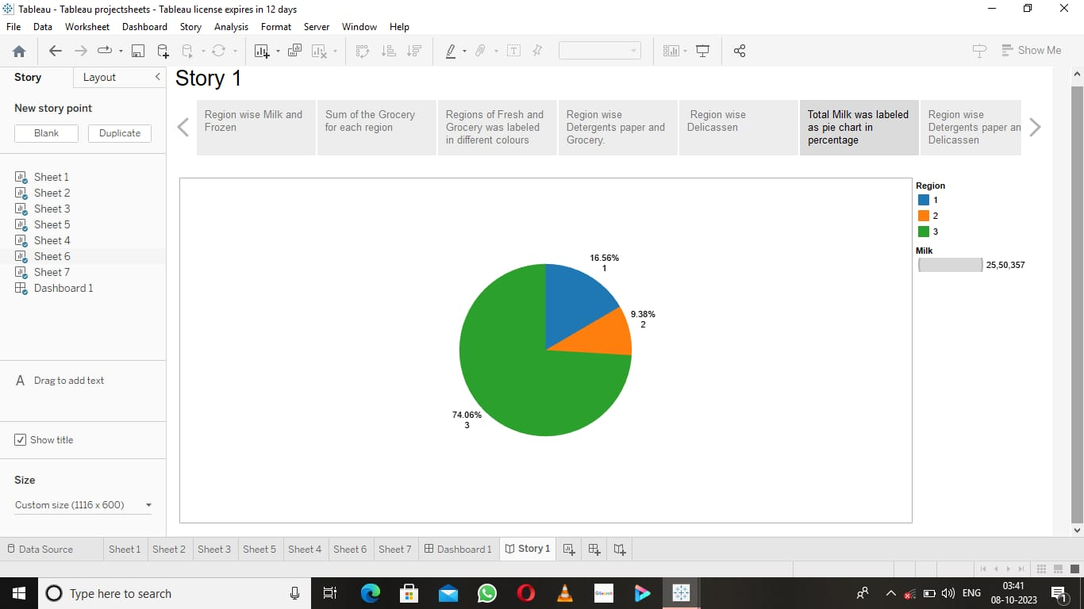
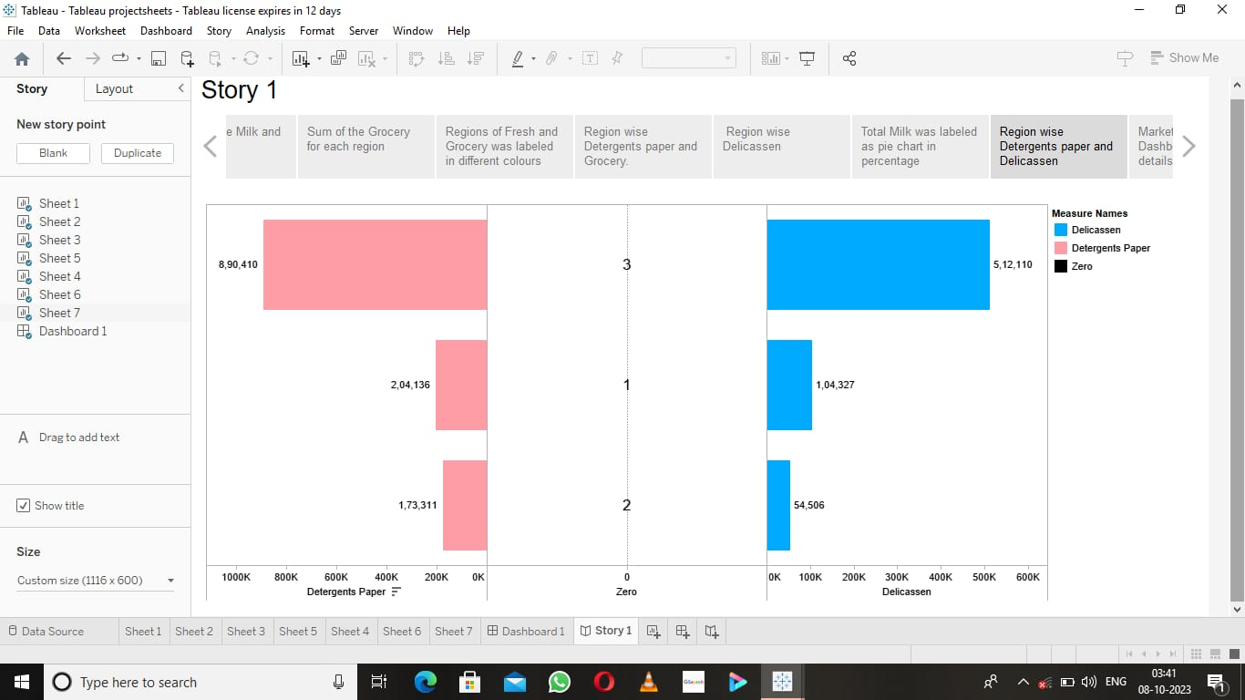

Slide 14
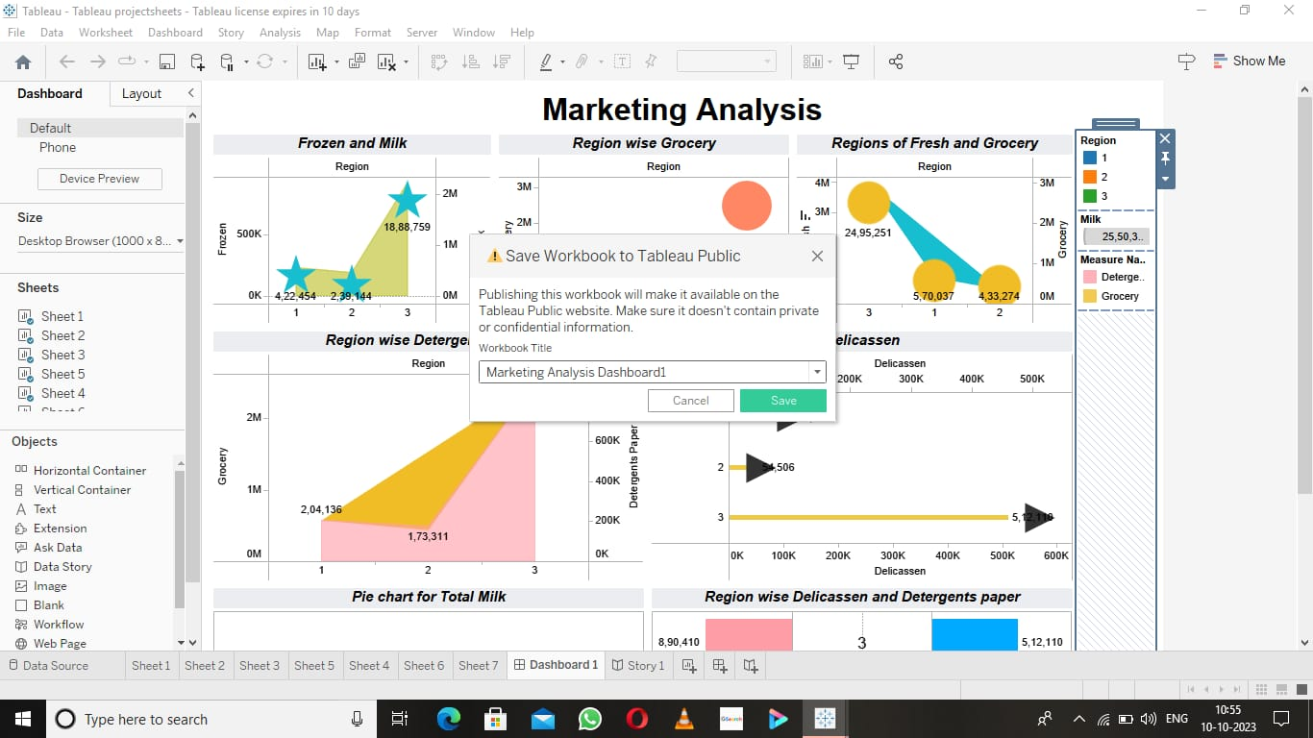
Activity 6 : Publishing
Publishing Dashboard and Reports to Tableau
Connecting the Dashboard to Tableau Public

Slide 15
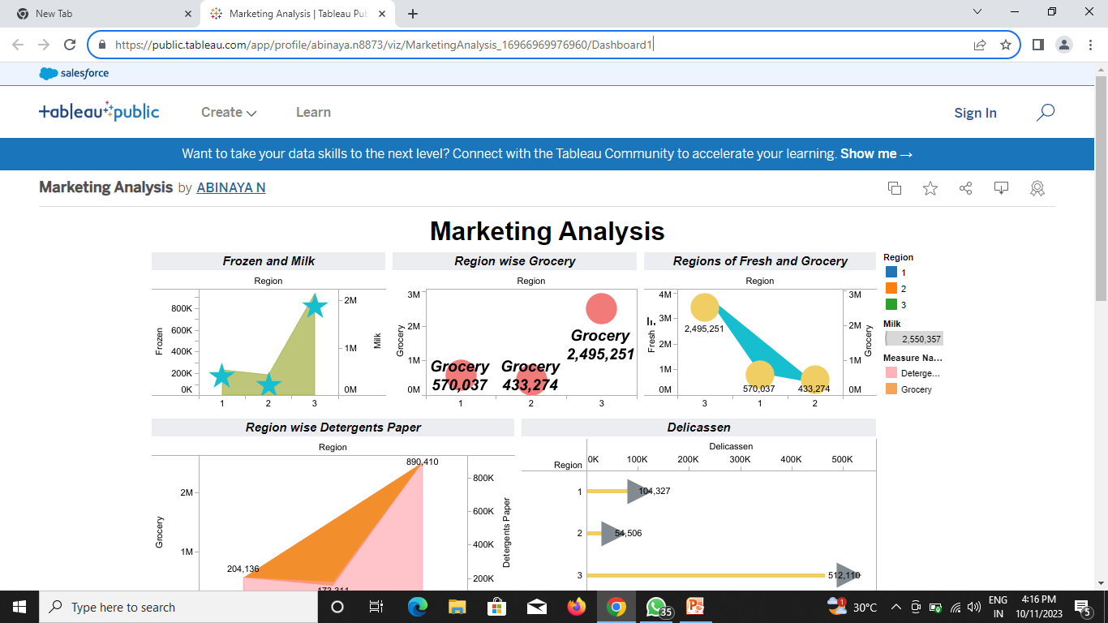
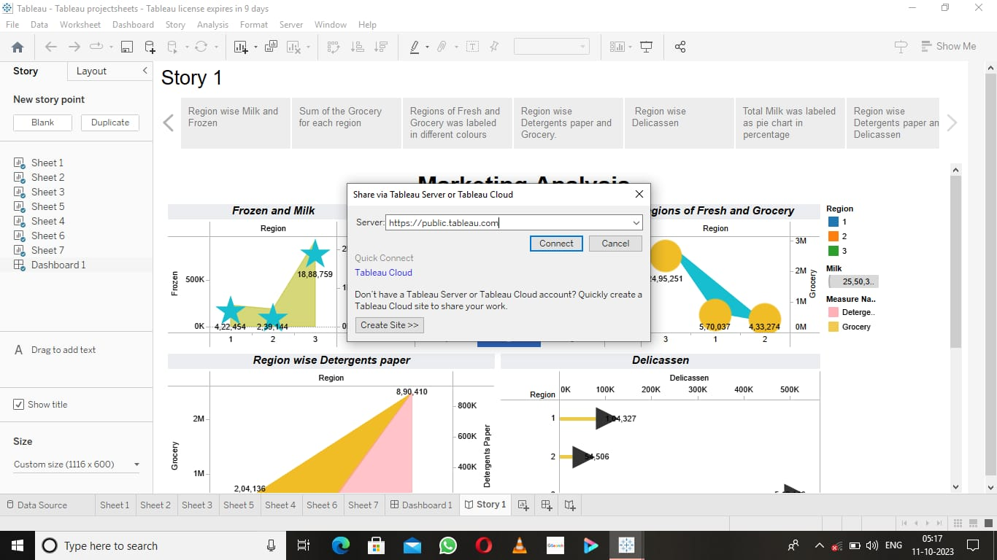
Published Dashboard
Publishing Story and Reports to Tableau
Connecting Story to Tableau Public

Slide 16
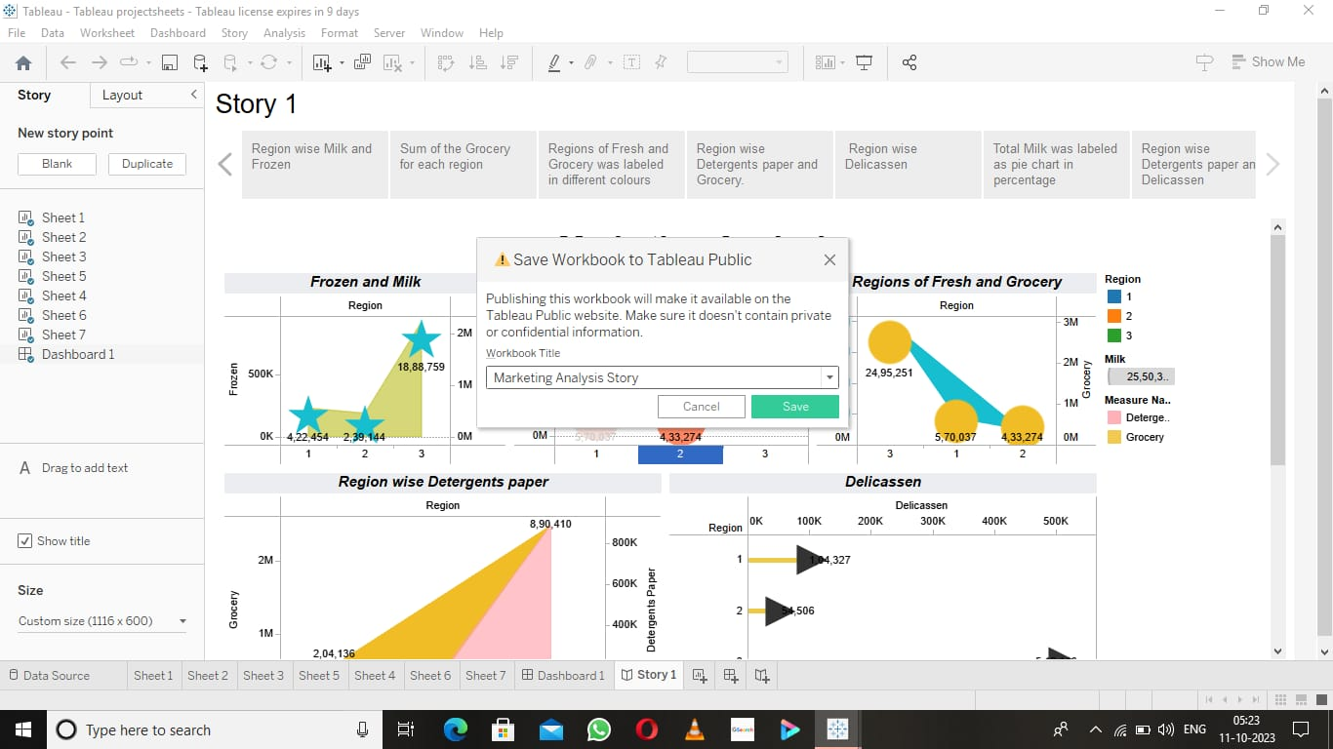
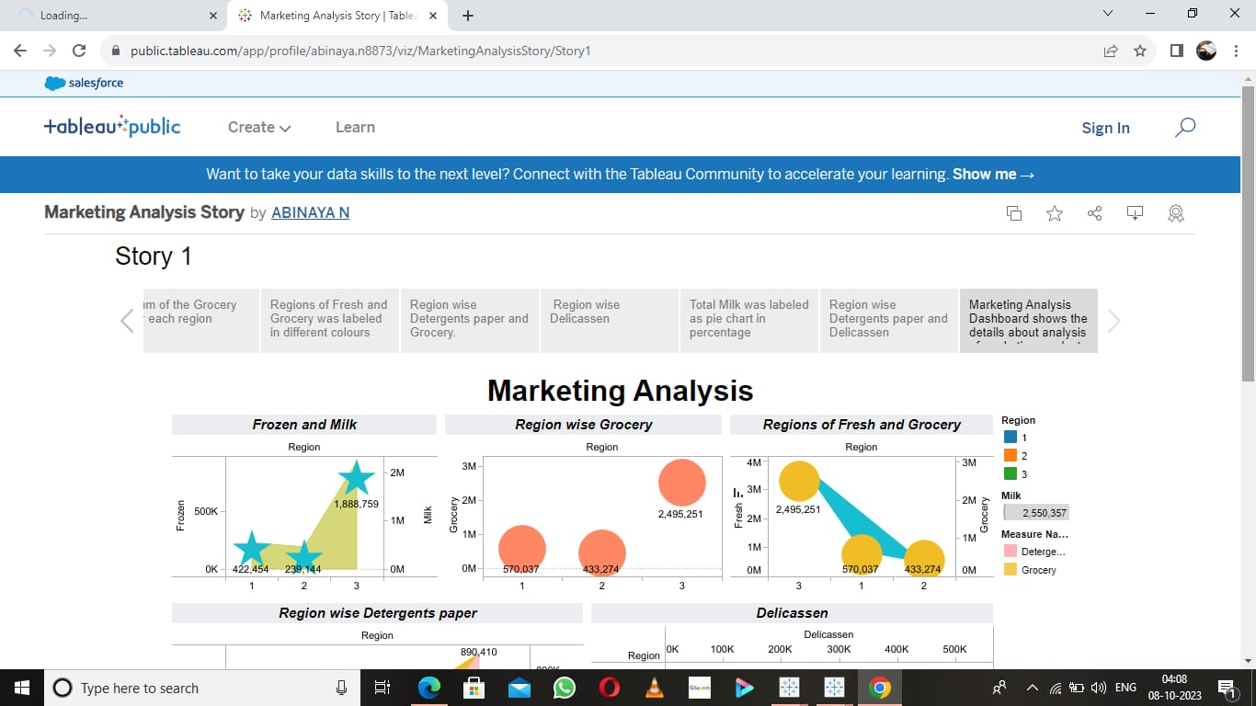
Saving the Story
Published Story

Slide 17
Advantages & Disadvantages
Advantages :
By designing and administering surveys, businesses can collect large amounts of data from a diverse group of respondents.
Surveys allow companies to gather information about consumer preferences, buying behaviors, and satisfaction levels.
The data collected can be statistically analyzed to identify trends, patterns, and correlations.
Experiments are conducted to test hypotheses and determine cause-and-effect relationships.

Slide 18
By manipulating variables and observing the outcomes, businesses can gain insights into consumer responses to specific changes in their products, services, or marketing strategies.
Experiments provide valuable data that can be used to make informed decisions and optimize business processes.
Disadvantages :
A market analysis does not guarantee an accurate diagnosis of a market. I
t merely analyzes a fragment of the market covered in the research, which would not be a fair representation of the whole market.
It may not also be possible to have a single market analysis covering all the parameters in the market such as price, demand and consumer preferences.

Slide 19
Solutions to Apply
Areas where this solution can
be applied :
To conduct market research analysis, businesses can utilize primary and secondary research methods.
Primary research involves collecting new data directly from the target audience through surveys, experiments, or observational studies.
On the other hand, secondary research involves analyzing existing data from various sources, such as industry reports, government publications, and academic studies.
Both primary and secondary research provides valuable information that can contribute to a comprehensive market analysis.

Slide 20
Conclusion :
Market research analysis is a powerful tool for businesses to gain a competitive edge in today’s dynamic marketplace.
By harnessing the power of data and extracting meaningful insights, companies can make informed decisions, understand consumer needs, and identify growth opportunities.
Effective market research analysis enables businesses to stay relevant, innovative, and successful in their respective industries.
To take your market research analysis to the next level and drive your business forward, request a demo from Aim Technologies.

Slide 21
Our cutting-edge solutions and expertise in market research can provide you with actionable insights that will propel your business to new heights.
Don’t miss out on the opportunity to make data-driven decisions and stay ahead of the competition
Future Scope :
Advancements in
1)automation
2)artificial intelligence and
3) big data analytics
are shaping the future of market research analysis, enabling faster and more insightful decision-making.

